Slide 1
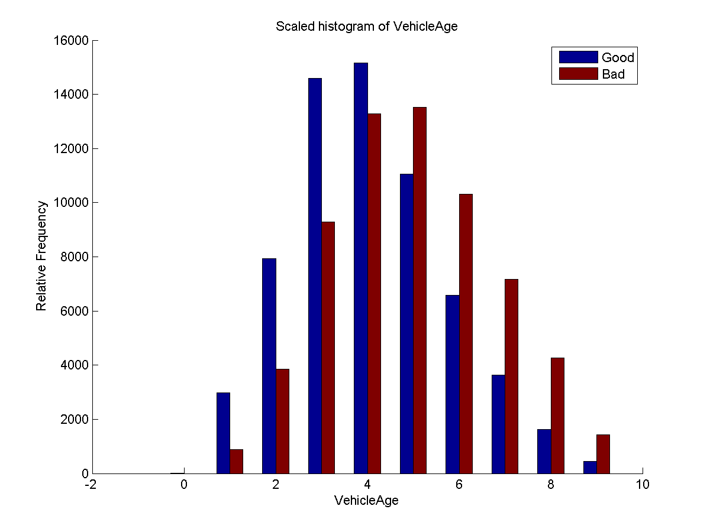
Don’t Get Kicked – Machine Learning Predictions for Car Buying
Albert Ho, Robert Romano, Xin Alice Wu – Department of Mechanical Engineering, Stanford University – CS229: Machine Learning
Introduction
Algorithm Selection
Discussion
When you go to an auto dealership with the intent to buy a used car, you want a good selection to choose from. Auto dealerships purchase their used cars through auto auctions and they want the same things: to buy as many cars as they can in the best condition possible. Our task was to use machine learning to help auto dealerships avoid bad car purchases, called “kicked cars”, at auto auctions.
MATLAB
Our initial attempts to analyze the data occurred primarily in MATLAB. Because the data was categorized into two labels, good or bad car purchases, we used logistic regression and libLINEAR¹ v.1.92. Initial attempts at classification went poorly due to heavy overlap between our good and bad training sets³. We decided to follow a different approach based on the concept of boosting, which combines various weak classifiers to create a strong classifier⁴.
Weka
To use boosting algorithms, we used the software package called Weka² v. 3.7.7. Using Weka, we could apply libLINEAR and naïve bayes along with boosting algorithms such as adaBoostM1, logitBoost, and ensemble selection.
Data Preprocessing/Visualization
Data Characteristics
All of our data was obtained from the Kaggle.com challenge “Don’t Get Kicked” hosted by Carvana. Our data had the following characteristics:
Contained 32 features and 73041 samples
Contained binary, nominal, and numeric data
Was heavily skewed towards good cars, which represented 87.7% of our training data
Preprocessing
The steps we took to preprocess out data changed throughout the project and were as follows:
Converting nominal data to numeric and filling in missing data fields
Normalizing numeric data from 0 to 1
Balancing the data
Early Data Visualization
Performance Evaluation
Acknowledgement
We would like to thank Andrew Ng for teaching CS 229 this quarter along with all the TA’s for their great help on our project. Without them, we would never have learned about boosting, using the AUC metric, or using Weka, which all helped greatly.
Citations
[1] R.-E. Fan, et al. LIBLINEAR: A Library for Large Linear Classification, Journal of Machine Learning Research 9(2008), 1871-1874. Software available at http://www.csie.ntu.edu.tw/~cjlin/liblinear
[2] Mark Hall, et al. (2009); The WEKA Data Mining Software: An Update; SIGKDD Explorations, Volume 11, Issue 1.
[3] Xiong, Haitao, Junjie Wu, and Lu Liu. "Classification with Class Overlapping: A Systematic Study."
[4] Friedman, Jerome, et al."Additive logistic regression: a statistical view of boosting”. The annals of statistics 28.2 (2000): 337-407.

